Slide 1
Picture Perfect Using machine learning to capture pictures at the right moment
Contributors: Ernest Lee, Abhishek Banerjee, Somyajit Jena

Slide 2
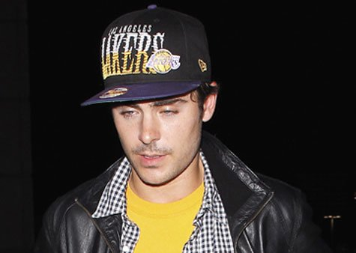
Problem: Bad pictures
Pictures that are taken at the wrong timing can have a negative impact on a person’s image. Have you ever seen ruined pictures because people accidentally blink or they forget to smile?

Slide 3
Solution: Use machine learning
We can use machine learning to:
Detect when a subject is “ready” (has their eyes open and are smiling) and have a device automatically take a picture
Prevent a device from taking pictures at the wrong time if the subject is “not ready” (person is blinking or not smiling)
Filter out bad pictures from a set of pictures

Slide 4
Getting started
First we have to find data to train our classifier

Slide 5
The Data Set
Face data was obtained from AT&T Laboratories Cambridge
http://www.cl.cam.ac.uk/research/dtg/attarchive/facedatabase.html
Data is a set of 400 images
40 people with 10 images each
Grayscale images
No class labels given

Slide 6
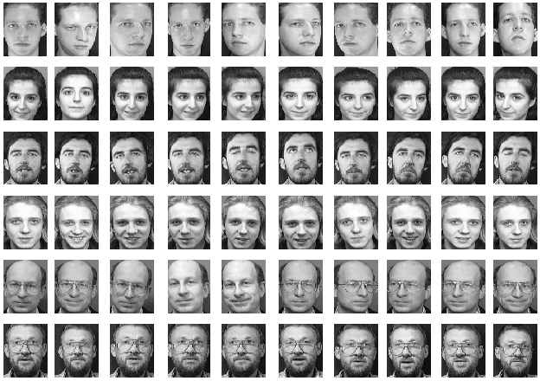
Sample data

Slide 7
First steps
Each image is converted to an array of digits and stored as a data set
Class labels are manually assigned to each of the images and stored as another data set
For this project, we had two classifications
Whether a person was smiling or not
Whether a person had their eyes open
We combined these two to create a class for Good Picture or Bad Picture

Slide 8




Classifying Good Picture vs Bad Picture
GOOD
BAD
Smiling
Not blinking
Not smiling
Blinking
Not smiling
Blinking

Slide 9
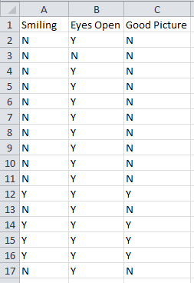
Sample Classification data set

Slide 10
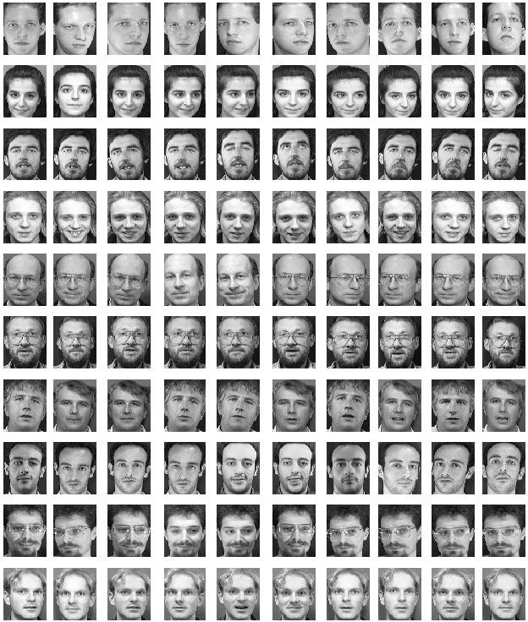
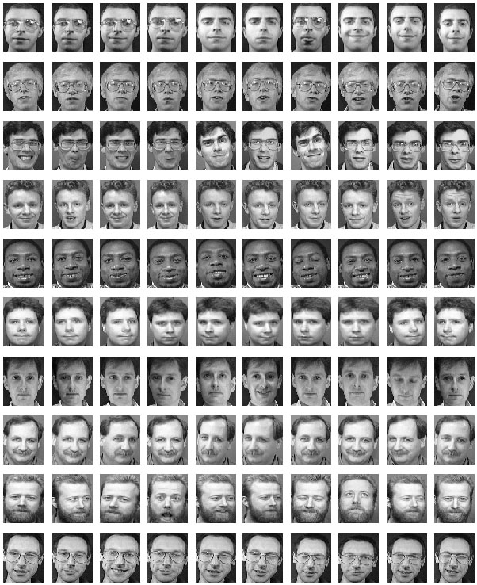
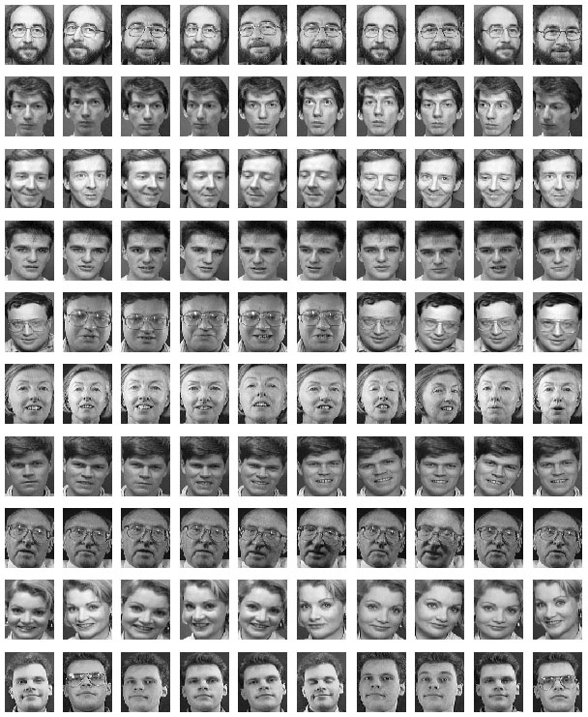
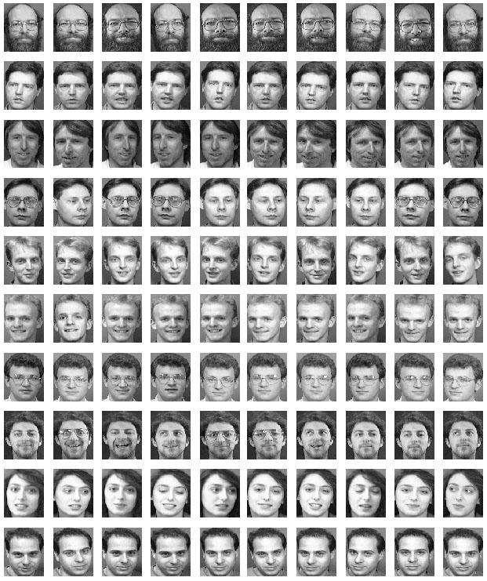
Creating a training and testing set
75% of the data was used as training data (300 images)
25% of the data was used as testing data (100 images)
Training Data
Testing Data

Slide 11
How do we build our classifier?
This is similar to MNIST because it uses images
Images can be converted to a single array of digits
Since a single image contains 10,304 elements, we can use Principal Component Analysis to reduce the dimensionality!
Use Logistic Regression to predict the class labels

Slide 12
Principal Component Analysis
SK learn was used to calculate the first and second principal components
A scatter plot was generated to help visualize the data

Slide 13
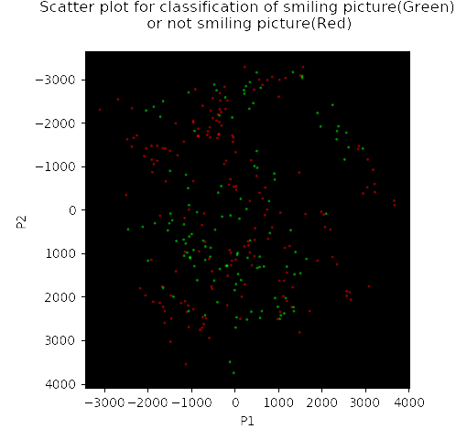
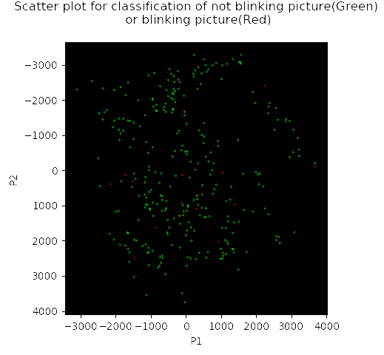
Scatter plot of smiling and blinking after PCA

Slide 14
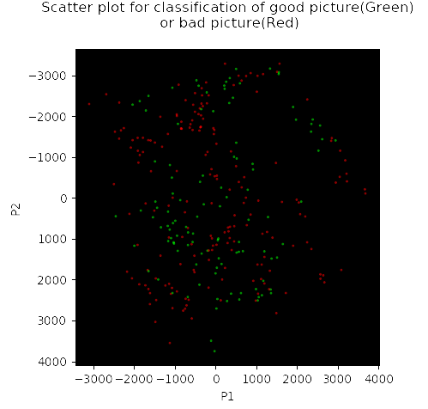
Scatter of “Good” and “Bad” picture after PCA

Slide 15
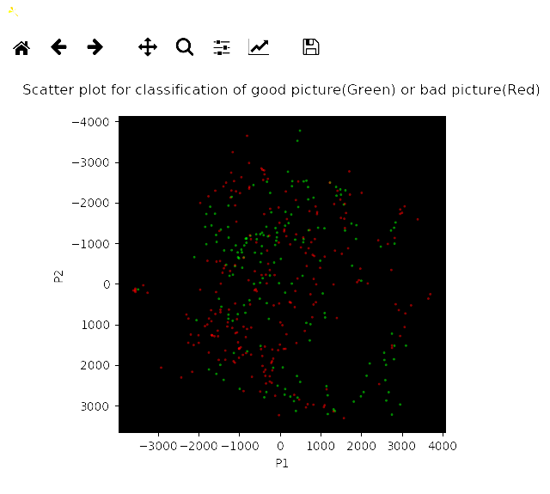
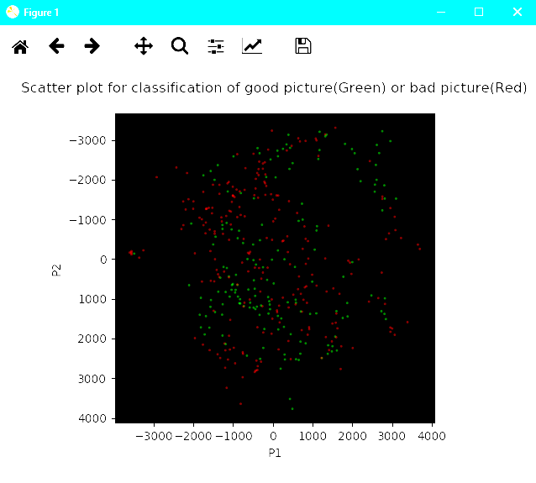
Pseudo code method vs SKLearn

Slide 16
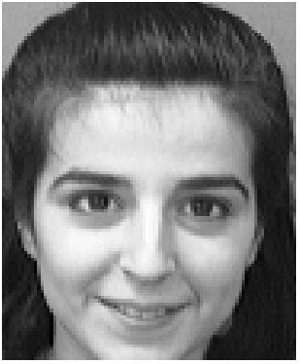
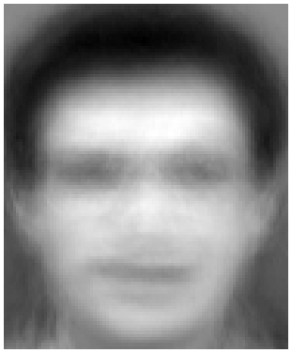
Keeping 2 components
Original
2 components

Slide 17
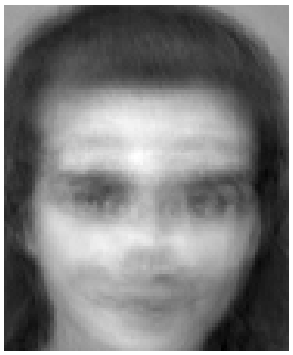
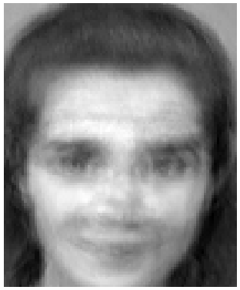
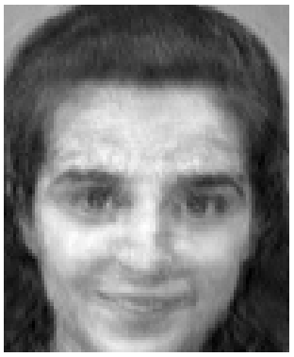
Keeping additional components
25
50
150

Slide 18
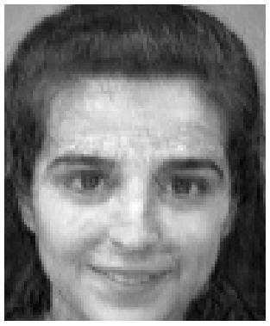
Keeping 200 components
Original
200 Components

Slide 19
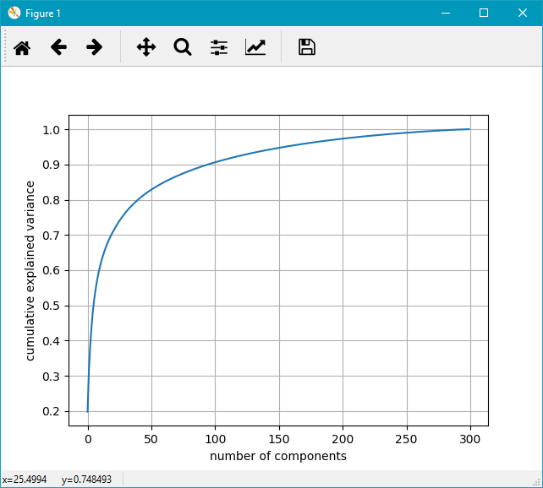
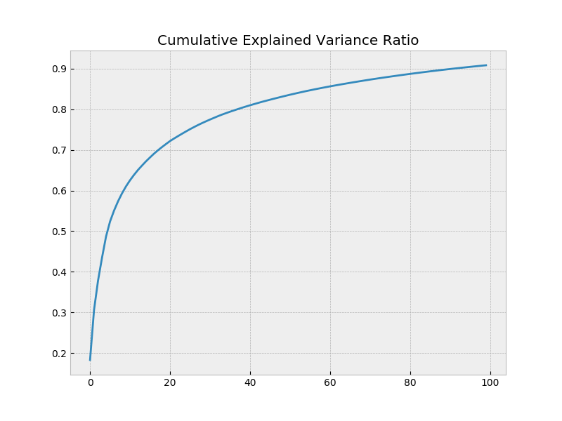
Explained Variance

Slide 20
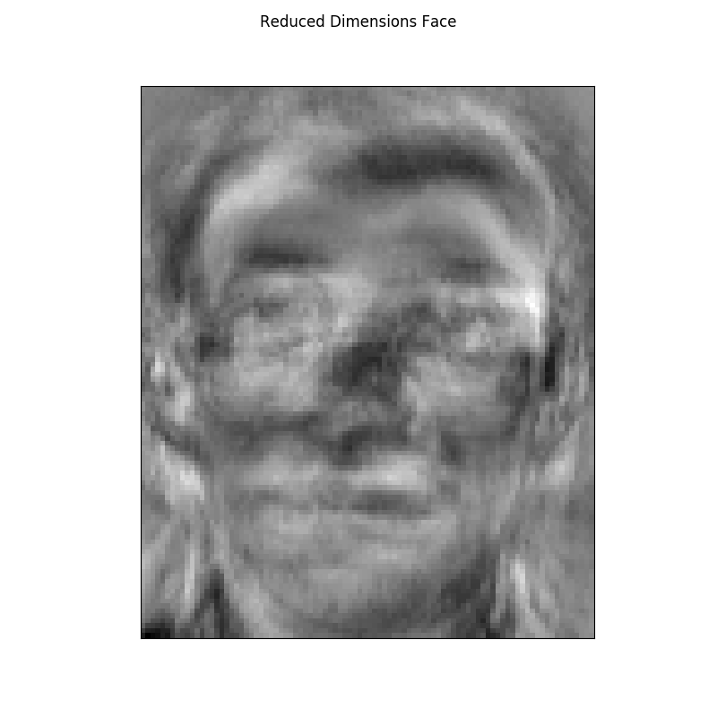
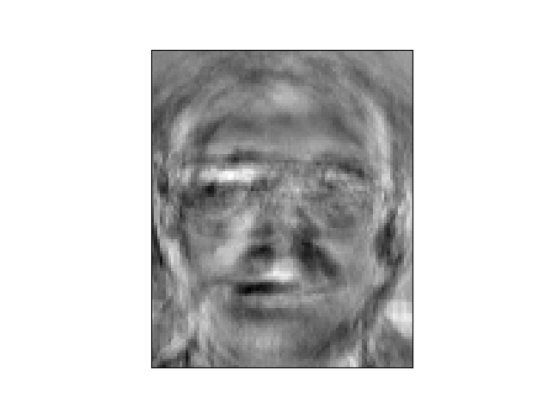
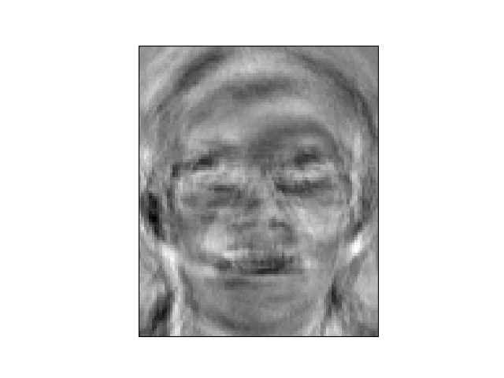
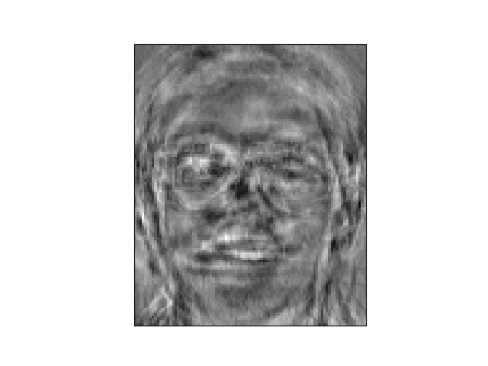
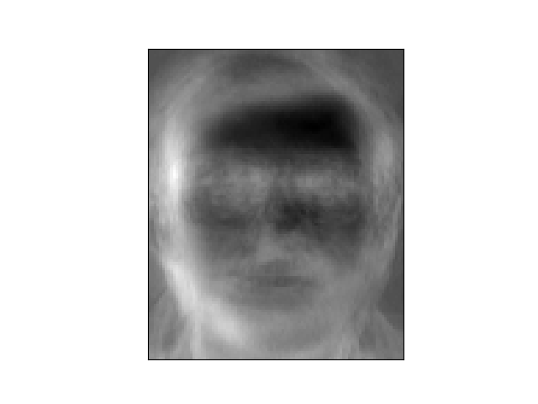
Reduced Dimension
PCA with 90% variance

Slide 21
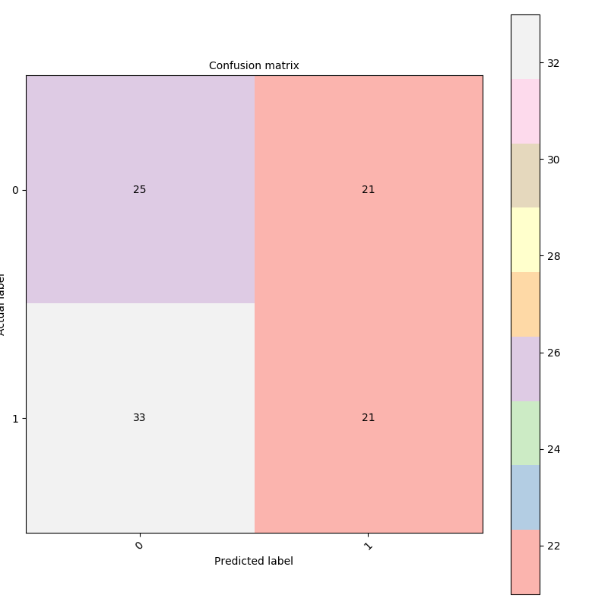
Confusion Matrix

Slide 22
Accuracy
55%

Slide 23
Conclusions
We may need more data in order to determine if this can follow a normal distribution
More data may give us better accuracy
If the number of features is very large, you may need to keep a lot more components
Sometimes there may be errors in manually classifying the data set

